Slide 1

Mathematical modelling for vaccine-preventable diseases
Dynamic models lecture 2
Interacting populations
Katy Gaythorpe
School of Public Health
Imperial College London
k.gaythorpe@imperial.ac.uk
Notes:
Introduce who we are

Slide 2
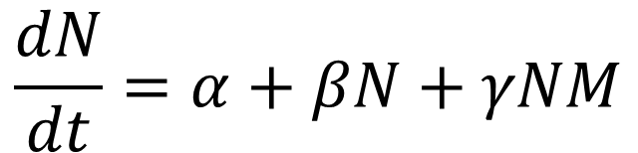

Single populations
Births
Deaths
$$\frac{ⅆN}{ⅆt}$$
Immigration
Emigration
Predation
$$\frac{dN}{dt}=α+βN+γNM$$
Add terms to describe mechanisms in your system
Consider how it will change your variable

Slide 3
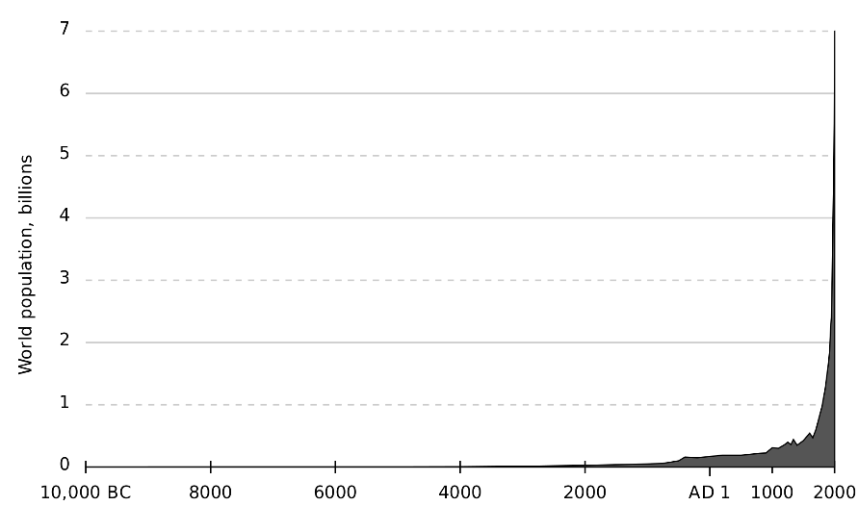
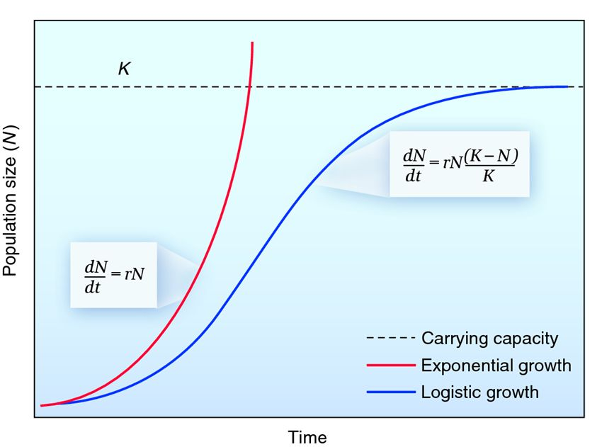

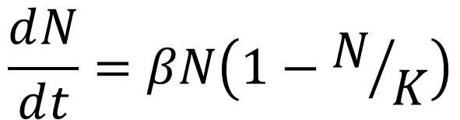
Single populations
Two key examples:
Exponential Growth
$$\frac{ⅆN}{ⅆt}=βN$$
Logistic Growth
$$\frac{ⅆN}{ⅆt}=βN\left(1−N/K\right)$$
Image Source: PPK @ biology-forums.com

Slide 4
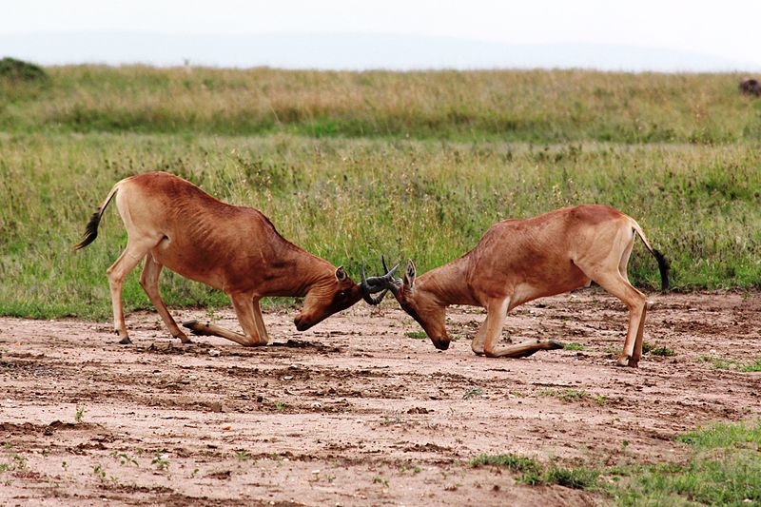
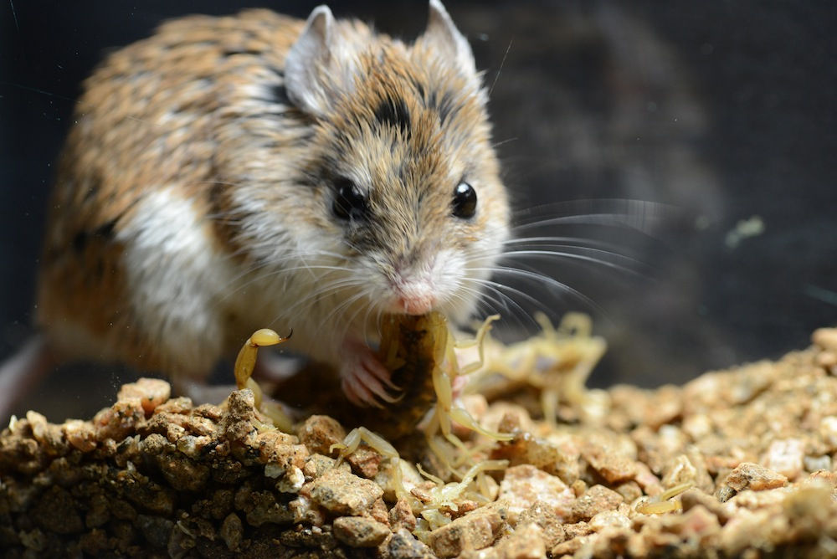
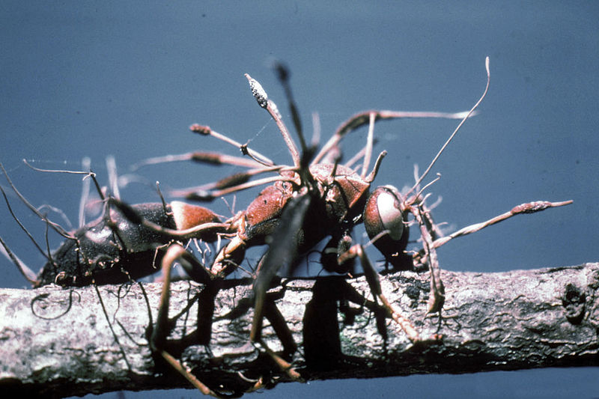
Interacting or coupled populations
Often we cannot consider a population in isolation
Image Source: Filip Lachowski
Credit: Ashlee and Matthew Rowe
Credit: Erich G. Vallery
Competition
Predation
Parasitism

Slide 5
Modelling interacting populations
The growth or decline of one species depends on the population size or concentration of the other species
Prey
Population density
Credit: Ashlee and Matthew Rowe
Predator
Time

Slide 6
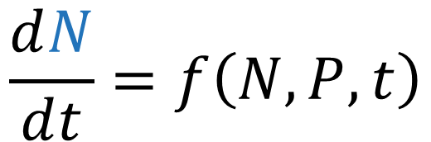
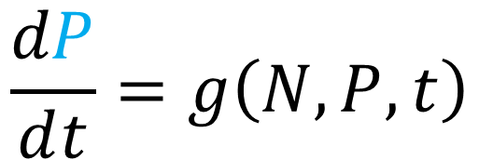
Modelling interacting populations
Show this through a set of coupled differential equations
$$\frac{ⅆN}{ⅆt}=f\left(N,P,t\right)$$
Prey
$$\frac{dP}{ⅆt}=g\left(N,P,t\right)$$
Credit: Ashlee and Matthew Rowe
Predator
Population density
Time

Slide 7
Outline
Bacteria- Amoeba Model
Mathematical techniques for analysing models of interacting populations
Computational techniques

Slide 8
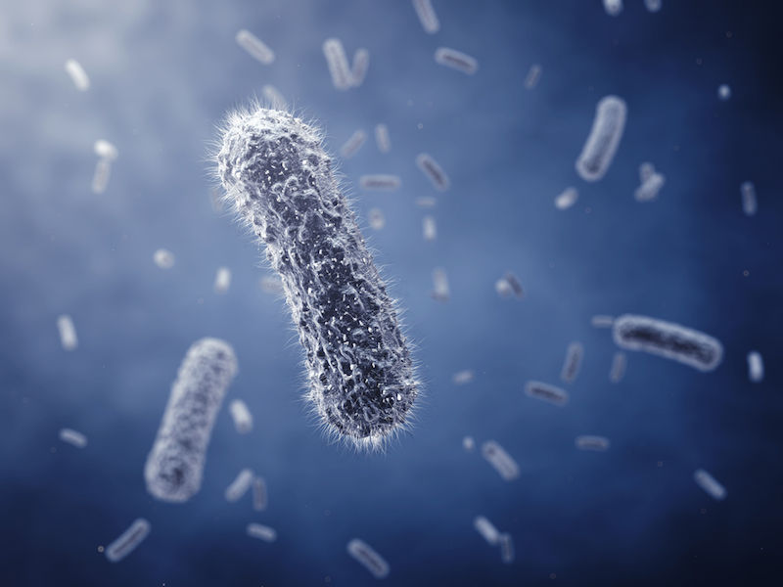
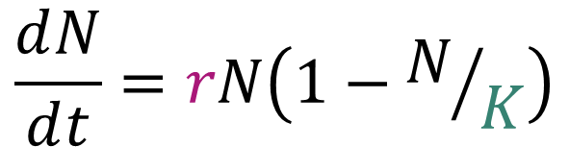
Bacteria dynamics: the prey
In the absence of amoeba, bacteria population grows according to the logistic equation
$$\frac{ⅆN}{ⅆt}=rN\left(1−N/K\right)$$
Constant per-capita growth rate
Credit: nobeastsofierce/Shutterstock.com
Carrying capacity due to within species competition

Slide 9
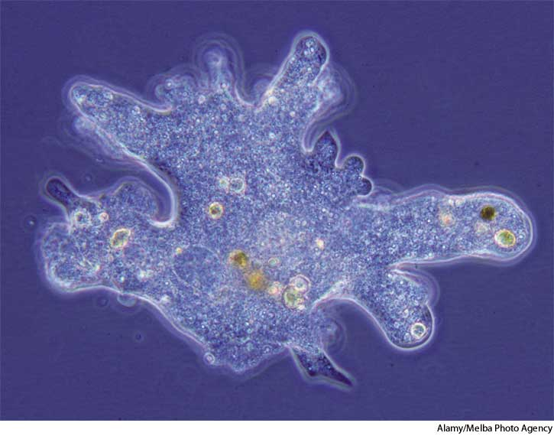
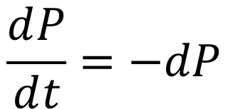
Amoeba dynamics: the predator
An amoeba population is introduced that feeds on the bacteria
Without the bacteria, the amoeba die
$$\frac{ⅆP}{ⅆt}=−dP$$

Slide 10
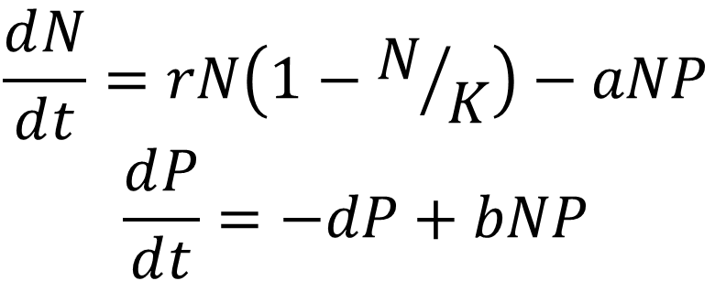
Joint dynamics
$$\frac{ⅆN}{ⅆt}=rN\left(1−N/K\right)−aNP$$
$$\frac{ⅆP}{ⅆt}=−dP+bNP$$
Bacteria
Amoeba
Interaction between amoeba and bacteria:
Bad for the bacteria/ prey: death
Good for the amoeba/ predator: growth

Slide 11
Set of coupled differential equations
$$\frac{ⅆN}{ⅆt}=rN\left(1−N/K\right)−aNP$$
$$\frac{ⅆP}{ⅆt}=−dP+bNP$$
Bacteria
Amoeba
Equations are coupled so they depend on each other
We cannot solve them independently
Therefore, we use other methods to analyse them

Slide 12
Phase diagrams
A graph describing the population dynamics of the two species
Curves of trajectories on the phase plane describe how the two species change over time with respect to each other

Slide 13
Interpreting phase diagrams
Eventually, after oscillating around the equilibrium point, we reach steady state

Slide 14
How to construct phase diagram curves
Approximations to phase diagrams can be constructed by hand
These contain the key features but have less detail

Slide 15
How to construct phase diagram curves
Approximations to phase diagrams can be constructed by hand
1
Find the equilibrium points

Slide 16
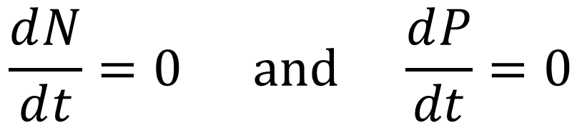
What is an equilibrium point?
An equilibrium is a steady state
At this point, the system does not change
therefore the population sizes remain constant
As such, the rate of change of each population is zero
$$\frac{ⅆN}{ⅆt}=0 \text{and} \frac{ⅆP}{dt}=0$$

Slide 17
What is an equilibrium point?
An equilibrium is a steady state
At this point, the system does not change
therefore the population sizes remain constant

Slide 18
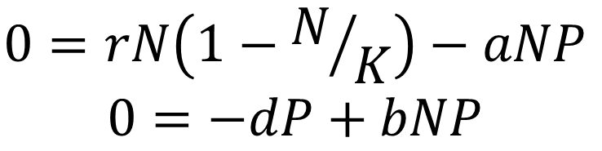

What is an equilibrium point?
$$\frac{ⅆN}{ⅆt}=rN\left(1−N/K\right)−aNP$$
$$\frac{ⅆP}{ⅆt}=−dP+bNP$$
The rate of change of each population is zero:
$$\frac{ⅆN}{ⅆt}=0 \text{and} \frac{ⅆP}{dt}=0$$
$$0=rN\left(1−N/K\right)−aNP$$
$$0=−dP+bNP$$

Slide 19
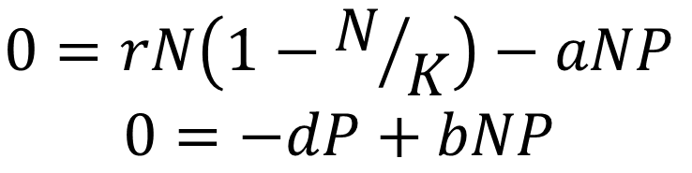
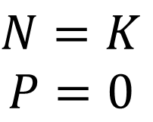
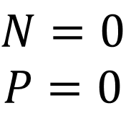
What is an equilibrium point?
$$0=rN\left(1−N/K\right)−aNP$$
$$0=−dP+bNP$$
We solve this simultaneously to arrive at three equilibrium points
$$N=0$$
$$P=0$$
$$N=K$$
$$P=0$$

Slide 20
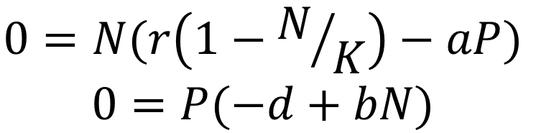
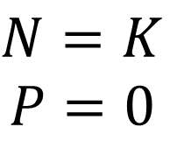
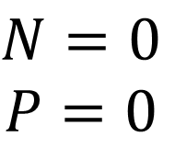
What is an equilibrium point?
$$0=N(r\left(1−N/K\right)−aP)$$
$$0=P(−d+bN)$$
We solve this simultaneously to arrive at three equilibrium points
$$N=0$$
$$P=0$$
$$N=K$$
$$P=0$$

Slide 21
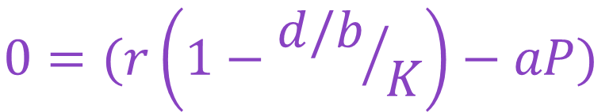
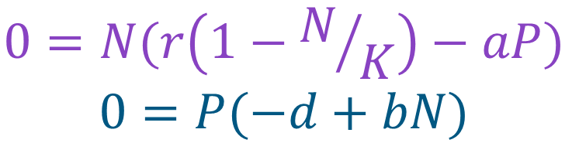
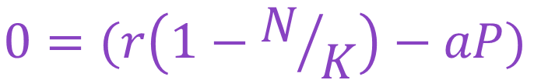


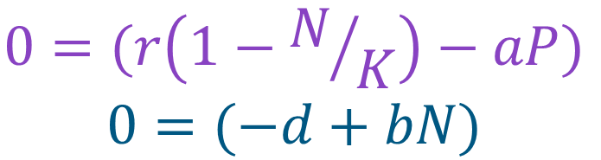
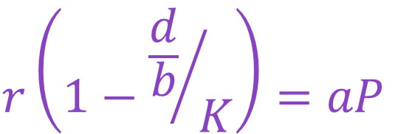
What is an equilibrium point?
$$0=N(r\left(1−N/K\right)−aP)$$
$$0=P(−d+bN)$$
$$0=(r\left(1−N/K\right)−aP)$$
$$0=(−d+bN)$$
$$0=(r\left(1−N/K\right)−aP)$$
$$0=(r\left(1−{d/b}/K\right)−aP)$$
$$0=(−d+bN)$$
$$r\left(1−{\frac{d}{b}}/K\right)=aP$$
$$N=d/b$$

Slide 22
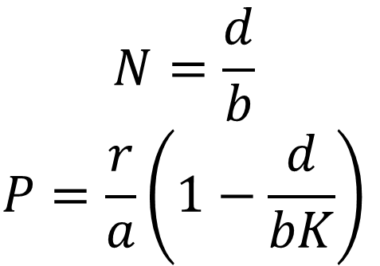
What is an equilibrium point?
$$0=N(r\left(1−N/K\right)−aP)$$
$$0=P(−d+bN)$$
We solve this simultaneously to arrive at three equilibrium points
$$N=\frac{d}{b}$$
$$P=\frac{r}{a}\left(1−\frac{d}{bK}\right)$$
$$N=0$$
$$P=0$$
$$N=K$$
$$P=0$$

Slide 23
Interpreting equilibrium points

Slide 24
How to construct phase diagram curves
1
Find the equilibrium points
2
Calculate form of nullclines

Slide 25
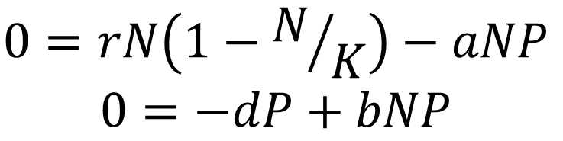
What is a nullcline?
Similar to an equilibrium point
These are lines or curves where one species is unchanging
N nullclines satisfy
P nullclines satisfy
$$0=rN\left(1−N/K\right)−aNP$$
$$0=−dP+bNP$$

Slide 26
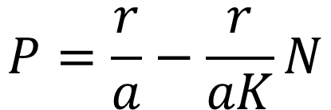
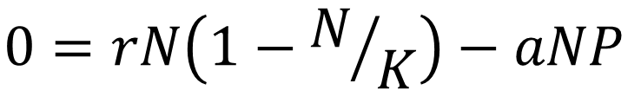

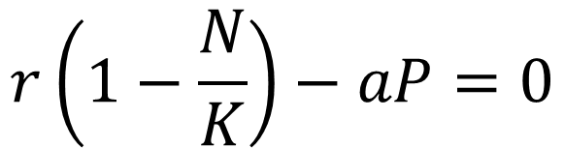

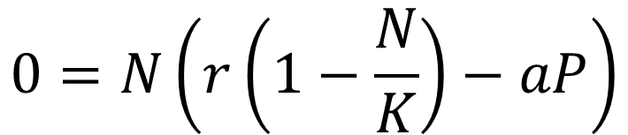
What is a nullcline?
N nullclines satisfy
$$0=rN\left(1−N/K\right)−aNP$$
$$0=N\left(r\left(1−\frac{N}{K}\right)−aP\right)$$
$$r\left(1−\frac{N}{K}\right)−aP=0$$
$$N=0$$
or
Two N nullclines:
and
$$P=\frac{r}{a}−\frac{r}{aK}N$$
$$N=0$$

Slide 27




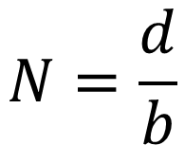

What is a nullcline?
P nullclines satisfy
$$0=−dP+bNP$$
$$0=P\left(bN−d\right)$$
$$P=0$$
or
$$bN−d=0$$
Two P nullclines:
and
$$N=\frac{d}{b}$$
$$P=0$$

Slide 28
What is a nullcline?
We can plot these nullclines on a phase diagram
The equilibrium points lie on the intersection

Slide 29
What is a nullcline?
We can start to understand some of the dynamics
By examining the change in a variable at a specific
point, we can begin to add directions to the phase
diagram

Slide 30
How to construct phase diagram curves
1
Find the equilibrium points
2
Calculate form of nullclines
3
Infer entire direction field

Slide 31
What is a nullcline?

Slide 32
What is a nullcline?
It is important to be able to interpret dynamics of individual populations from phase trajectories

Slide 33
How to construct phase diagram curves
We can also compute the phase diagram
This allows us to quickly try different trajectories

Slide 34
How to construct phase diagram curves
We can also compute the phase diagram
1
Build a direction field to drive the curve’s evolution
2
Allow the computer to fill in the gaps
3
Choose an initial point and examine the resulting trajectory

Slide 35
How to construct phase diagram curves
We can also compute the phase diagram

Slide 36
How to construct phase diagram curves
We can also compute the phase diagram
This equilibrium point is globally stable

Slide 37
Summary
When populations of several species interact (through competition, predation etc.) the dynamics of each species are not independent. Therefore we use coupled differential equations to describe them.
Analytical solutions almost never exist in these situations.
We therefore can determine qualitative and long –term behavior with mathematical analysis.
Or, analyse the equations numerically and investigate the dynamics graphically.

Slide 38
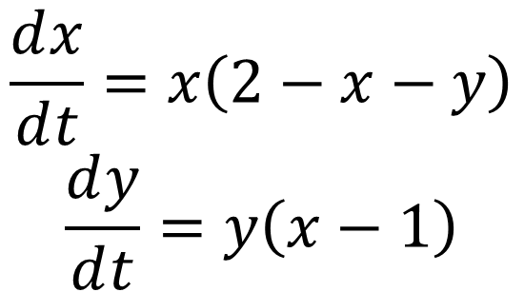
Example
$$\frac{ⅆx}{ⅆt}=x\left(2−x−y\right)$$
$$\frac{ⅆy}{ⅆt}=y\left(x−1\right)$$

